Slide 1
NSF Cyberinfrastructure Framework
for 21st Century Science
and Engineering (CF21)
Ed Seidel
NSF Assistant Director, Mathematical and Physical Sciences
Alan Blatecky
Director, NSF Office of Cyberinfrastructure
NSF-wide Cyberinfrastructure Vision
People, Sustainability, Innovation, Integration
1
Notes:
This is an update on the CF21 presentation given at the Feb NSB meeting

Slide 2
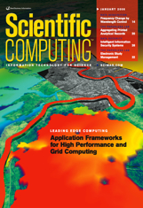
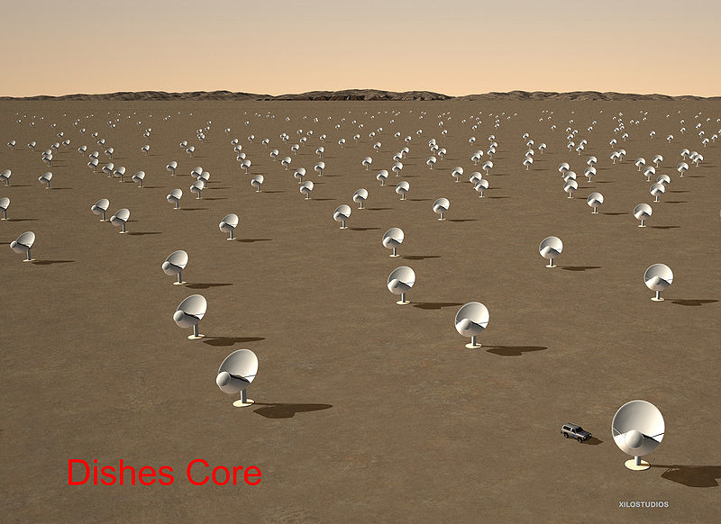
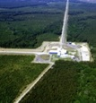
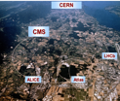
Framing the Question Science is Radically Revolutionized by CI
Modern science
Data- and compute-intensive
Integrative
Multiscale Collaborations for Complexity
Individuals, groups, teams, communities
Must Transition NSF CI approach to support
Integrative, multiscale
4 centuries of constancy, 4 decades 10⁹⁻¹² change!

Slide 3
Cyberinfrastructure Ecosystem (CF21)
Organizations
Universities, schools
Government labs, agencies
Research and Medical Centers
Libraries, Museums
Virtual Organizations
Communities
Expertise
Research and Scholarship
Education
Learning and Workforce Development
Interoperability and operations
Cyberscience
Scientific Instruments
Large Facilities, MREFCs,,telescopes
Colliders, shake Tables
Sensor Arrays
- Ocean, environment, weather,
buildings, climate. etc
Discovery
Collaboration
Education
Data
Databases, Data repositories
Collections and Libraries
Data Access; storage, navigation
management, mining tools,
curation, privacy
Computational Resources
Supercomputers
Clouds, Grids, Clusters
Visualization
Compute services
Data Centers
Networking
Campus, national, international networks
Research and experimental networks
End-to-end throughput
Cybersecurity
Software
Applications, middleware
Software development and support
Cybersecurity: access,
authorization, authentication
Maintainability, sustainability, and extensibility

Slide 4
Cannot be done without New CI
Unprecedented amounts of data collected across planet (by many orders of magnitude)
Earth Systems
Integrated observations, sensors, simulations
Time Domain Astronomy
LSST + radio, cosmic ray, gravity waves
Need completely new algorithms, method, tools
Communities connect by sharing data, software; communicate through social networks, mobile devices
Simulations by global teams
Astronomy: Gravity, hydro, MHD, nuclear EOS, radiation transport; global teams, PB output
Multiple communities must engage rapidly, integrate observations, expertise
Share data, software, visualizations, in real time
International cooperation on CI, data policies can enable
Will require integrated CI across disciplines, end-to-end

Slide 5
CI Partnering Opportunities
Common policies/agreements on open access to scientific data
Coordinated international data infrastructure and services
Examples: impact on astronomy, geosciences could be huge
Common approaches to Authentication and Authorization
Cloud and Grid coordination, development and interoperability efforts towards sustainability

Slide 6
CI Partnering Opportunities: Possible specific calls for joint actions
Coordinated call for Innovations in International Distributed computing for science and engineering
Joint distributed computing support for LHC, LIGO, etc
Integrated approaches to sustainability
Coordinated call on software sustainability efforts
Support exchanges of personnel between e-Infrastructure operators and joint dissemination projects (e.g. on RI initiatives across the Atlantic)
Networks

Slide 7
Thank You

Slide 8
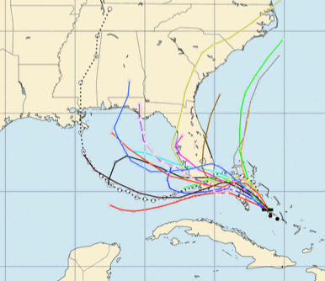
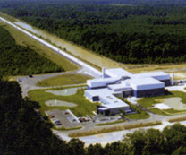
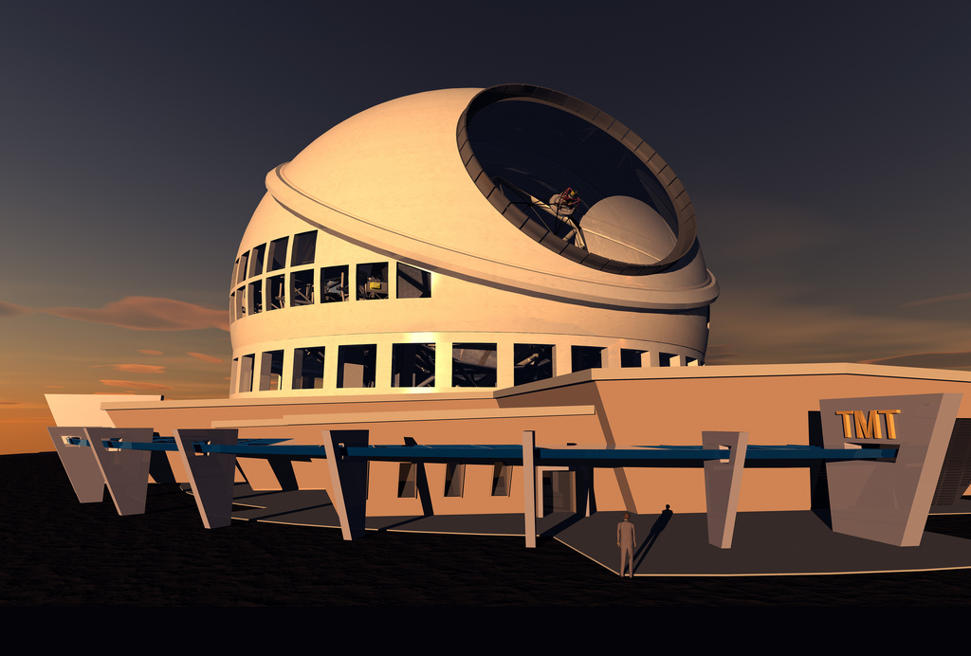
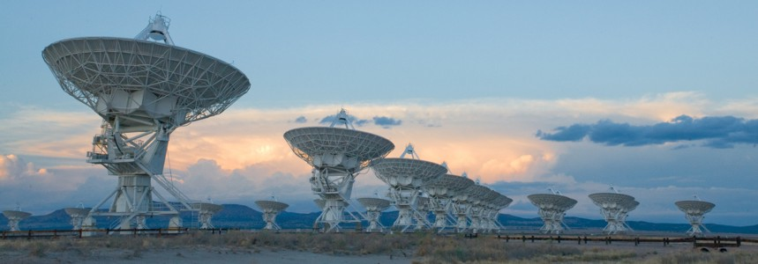
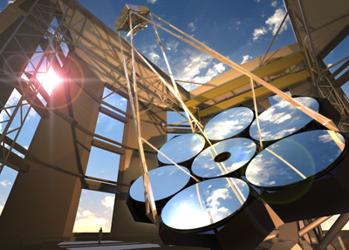
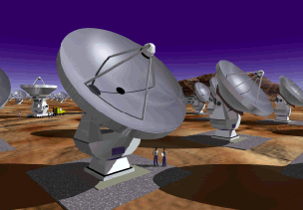
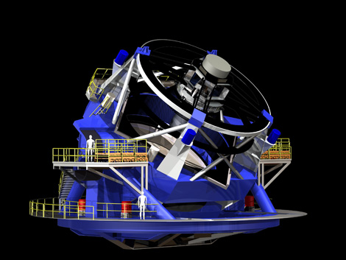
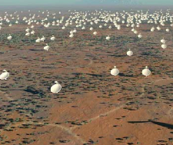
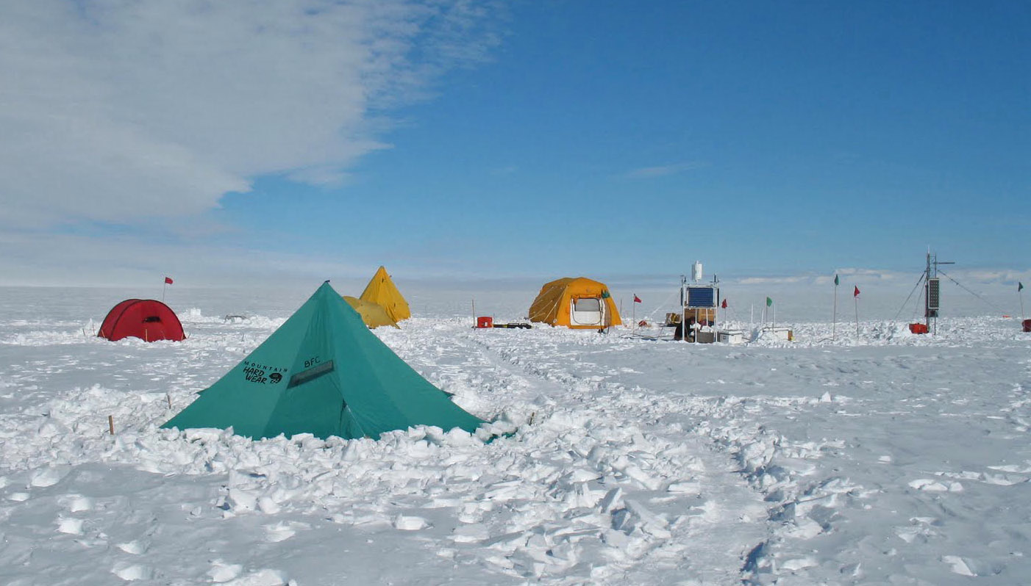
Transient & Data-intensive Astronomy
New era: seeing events as they occur
(Almost) here now
ALMA, EVLA in radio
Ice Cube neutrinos
On horizon
24-42m optical?
LIGO south?
LSST = SDSS (40TB) every night!
SKA = exabytes
Simulations integrate all physics
Astronomy 1500-2010 was passive. No longer!
?

Slide 9
Earth Systems and CF21
A Complex Interconnected Earth System
Notes:
Enabling Role of CI
-- CI activities orchestrated to increase the productivity and capability of researchers and educators -- Invest in multiple approaches and demand multiple outcomes
-- Community driven direction and priority
-- Understand the full lifecycle costs and the importance of sustainability
-- Balanced needs: computing, data, people, networks, visualization, etc.
-- CI 21 will be essential to address the challenges in GEO’s strategy “GEO Vision”

Slide 10
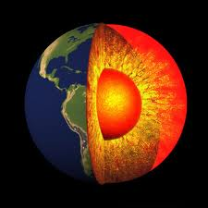
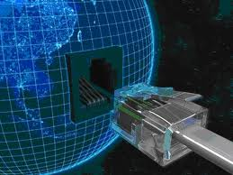
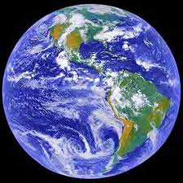
Earth–Human Knowledge Management System (Earth-Cubed)
for
Discovery Observing Simulating
Sharing Collaborating Training
 Learning  Informing Broadening Participation
Notes:
3-D cube with three pictures
(Intermediate)
To reproduce the picture-filled cube on this slide, do the following:
On the Home tab, in the Slides group, click Layout, and then click Blank.
On the Insert tab, in the Illustrations group, click Picture. In the Insert Picture dialog box, select a picture, and then click Insert.
Select the picture. Under Picture Tools, on the Format tab, in the bottom right corner of the Size group, click the Size and Position dialog box launcher. In the Size and Position dialog box, on the Size tab, resize or crop the picture as needed so that under Size and rotate, the Height box is set to 3.42” and the Width box is set to 3.42”. Resize the picture under Size and rotate by entering values into the Height and Width boxes. Crop the picture under Crop from by entering values into the Left, Right, Top, and Bottom boxes.
Under Picture Tools, on the Format tab, in the bottom right corner of the Picture Styles group, click the Format Shape dialog box launcher. In the Format Picture dialog box, in the left pane, click Line Color. In the Line Color pane, select Solid line, click the button next to Color, click More Colors, and then in the Colors dialog box, on the Custom tab, enter values for Red: 8, Green: 18, Blue: 31.
Also in the Format Shape dialog box, click Line Style in the left pane, and then in the Line Style pane, in the Width box, enter 0.75 pt.
Also in the Format Shape dialog box, click 3-D Format in the left pane. In the 3-D Format pane, under Bevel, click the button next to Top, and then under Bevel click Convex (second row, third option from the left). Next to Top, in the Width box, enter 6 pt, and in the Height box, enter 6 pt.
Select the picture. On the Home tab, in the Clipboard group, click the arrow under Paste, and then click Duplicate. Repeat this process again to create a total of three pictures.
Drag the pictures on the slide so that each one is visible.
Select one of the duplicate pictures. Under Picture Tools, on the Format tab, in the Adjust group, click Change Picture. In the Insert Picture dialog box, select a picture and click Insert.
Under Picture Tools, on the Format tab, in the bottom right corner of the Size group, click the Size and Position dialog box launcher. In the Size and Position dialog box, on the Size tab, resize or crop the picture as needed so that under Size and rotate, the Height box is set to 3.42” and the Width box is set to 3.42”. Resize the picture under Size and rotate by entering values into the Height and Width boxes. Crop the picture under Crop from by entering values into the Left, Right, Top, and Bottom boxes.
Repeat steps 10-11 for the other duplicate picture.
Select the picture that will appear on the top side of the cube. Under Picture Tools, on the Format tab, in the Picture Styles group, click Picture Effects, point to 3-D Rotation, and then under Parallel click Off Axis 1 Top (second row, third option from the left).
Select the picture that will appear on the left side of the cube. Under Picture Tools, on the Format tab, in the Picture Styles group, click Picture Effects, point to 3-D Rotation, and then under Parallel click Off Axis 1 Left (second row, first option from the left).
Select the picture that will appear on the right side of the cube. Under Picture Tools, on the Format tab, in the Picture Styles group, click Picture Effects, point to 3-D Rotation, and then under Parallel click Off Axis 1 Right (second row, second option from the left).
Drag the pictures on the slide to create a cube. The edges of each picture may not line up exactly. To align the pictures as closely as possible, you may want to zoom in on the slide. On the View tab, click Zoom. In the Zoom dialog box, click 400%, and then drag the pictures on the slide.
Press and hold SHIFT and select all three pictures on the slide. On the Home tab, in the Drawing group, click Group.
On the Home tab, in the Editing group, click Select, and then click Selection Pane. To edit the name of the group, in the Selection and Visibility pane, double-click the group and enter Cube Group.
To reproduce the shadow effects on this slide, do the following:
On the Home tab, in the Drawing group, click Shape, and then under Rectangles click Rectangle (first option from the left). On the slide, drag to draw a rectangle.
Select the rectangle. Under Drawing Tools, on the Format tab, in the Size group, do the following:
In the Shape Height box, enter 3.42”.
In the Shape Width box, enter 3.42”.
On the Home tab, in the Drawing group, click the arrow next to Shape Fill, and then under Theme Colors click White, Background 1 (first row, first option from the left).
On the Home tab, in the Drawing group, click the arrow next to Shape Outline, and then click No Outline.
On the Home tab, in the bottom right corner of the Drawing group, click the Format Shape dialog box launcher. In the Format Shape dialog box, click 3-D Rotation in the left pane. In the 3-D Rotation pane, click the button next to Presets, and then under Parallel click Off Axis Top 1 (second row, third option from the left).
Also in the Format Shape dialog box, in the left pane, click Shadow. In the Shadow pane, click the button next to Presets, under Perspective click Below (first row, third option from the left), and then do the following:
In the Transparency box, enter 72%.
In the Size box, enter 110%.
In the Blur box, enter 41 pt.
In the Angle box, enter 115°.
In the Distance box, enter 111 pt.
On the Home tab, in the Drawing group, click Arrange, and then click Send to Back.
Drag the rectangle under the cube until the cube appears to be floating.
On the Home tab, in the Editing group, click Select, and then click Selection Pane. In the Selection and Visibility pane, press and hold CTRL and select both Cube Group and the rectangle. On the Home tab, in the Drawing group, click Arrange, and then click Group.
With the group still selected on the slide, on the Home tab, in the Drawing group, click Arrange, point to Align, and then do the following:
Click Align to Slide.
Click Align Center.
Click Align Middle.
To reproduce the background effects on this slide, do the following:
On the Design tab, in the Background group, click Background Styles, and then click Style 8 (second row, fourth option from the left). (Note: If this action is taken in a PowerPoint document containing more than one slide, the background style will be applied to all of the slides.)

